Slide 1
A “disease” approach in life extension advocacy can facilitate communication with the general public
Elena Milova, Keith Comito
info@lifespan.io

Slide 2
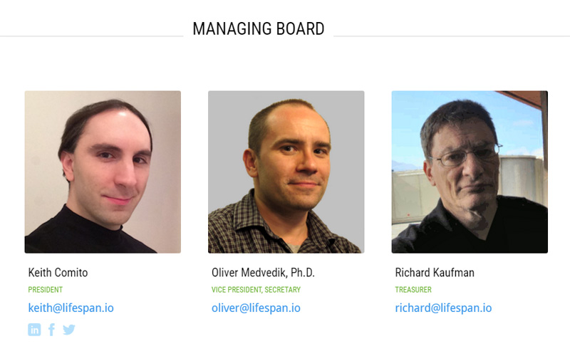
Life Extension Advocacy Foundation (LEAF)

Slide 3
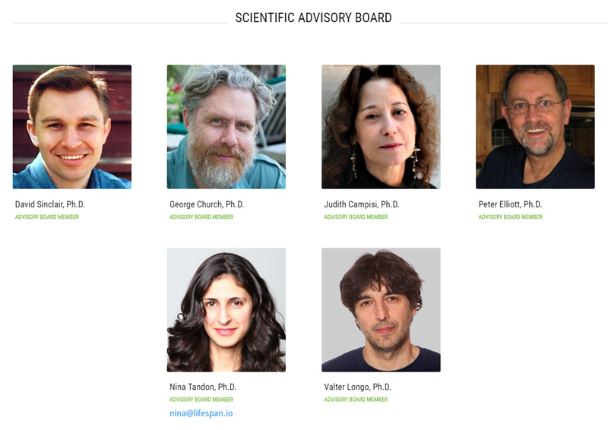
Life Extension Advocacy Foundation (LEAF)

Slide 4
Founded in 2015
Hosted 4 successful campaigns in support of aging and longevity studies
More than $200 000 collected for research
The results of one study have been already published*
Three studies are currently ongoing
* Boominathan, A., Vanhoozer, S., Basisty, N., Powers, K., Crampton, A. L., Wang, X., ... & O'Connor, M. S. (2016). Stable nuclear expression of ATP8 and ATP6 genes rescues a mtDNA Complex V null mutant. Nucleic acids research, 44(19), 9342-9357.

Slide 5
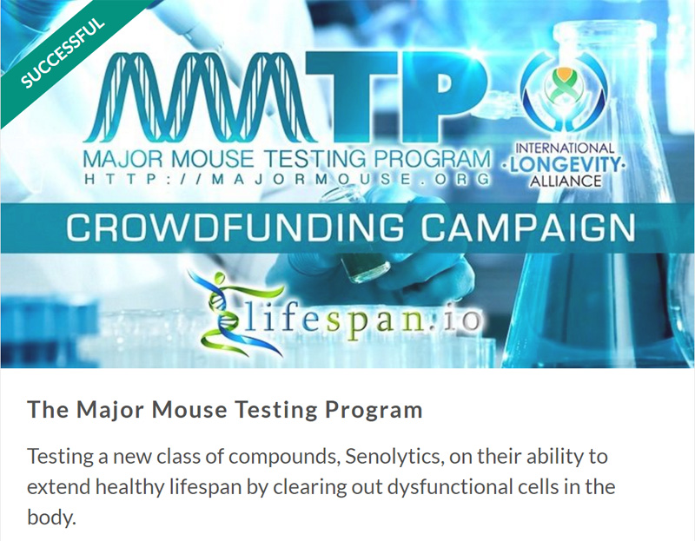
Campaigns hosted at Lifespan.io

Slide 6
Why engage the general public?
We still need more data on the mechanisms of aging, but the basic science is underfunded.
Without studies on cells and mice it is impossible to get to the stage of clinical trials in humans.
State funding is more often allocated to mainstream areas, such as research on single diseases.
Business does not have much interest in basic science, because usually there is no final product yet
that can be sold.

Slide 7
How to get more funding for gerontology?
Let’s become better at teaching!

Slide 8
Didactic principles we should not break
Active and conscious participation
Systematization
Accessibility and individual approach

Slide 9
Active and conscious participation: make the newcomer see the benefits
Don’t touch the fire:
For the newcomer, the expression “life extension” means extension of old age!
It also means “enhancement” which is often rejected.
Immortal people are pictured by pop culture as mad, morally inferior and bored.
Instead, make the benefits clear:
Addressing aging could lead to healthy life extension, and could allow us to cure or prevent age-related diseases.

Slide 10
Systematization: divide the material into small units and arrange them to follow the educational logic
Begin with simple, move to more complex:
Explain what aging is.
Explain the relationship between aging, damage accumulation and disease.
Explain how addressing aging mechanisms can lead to the extension of the healthy and youthful period of life.
www.leafscience.org/aging

Slide 11
Accessibility and individual approach: use simple language and discuss the concerns
Avoid being too technical, if you are not being understood then scientific terms do not matter.
www.leafscience.org/blog
Don’t refuse to discuss any concerns as people prefer to take into account the consequences before making important decisions about their values, health and money.
www.leafscience.org/education/concerns

Slide 12
Recommended papers to read
Lucke, J., Ryan, B., & Hall, W. (2006). What does the community think about lifespan extension technologies? The need for an empirical base for ethical and policy debates. Australasian Journal on Ageing, 25(4), 180-184.
Shepherd, R., Barnett, J., Cooper, H., Coyle, A., Moran-Ellis, J., Senior, V., & Walton, C. (2007). Towards an understanding of British public attitudes concerning human cloning. Social Science & Medicine, 65(2), 377-392.
Underwood, M. (2014). What reassurances do the community need regarding life extension? Evidence from studies of community attitudes and an analysis of film portrayals. Rejuvenation research, 17(2), 105-115.
Donner, Y., Fortney, K., Calimport, S. R., Pfleger, K., Shah, M., & Betts-LaCroix, J. (2015). Great desire for extended life and health amongst the American public. Frontiers in genetics, 6.
Partridge, B., Underwood, M., Lucke, J., Bartlett, H., & Hall, W. (2009). Ethical concerns in the community about technologies to extend human life span. The American Journal of Bioethics, 9(12), 68-76.
Partridge, B., Lucke, J., Bartlett, H., & Hall, W. (2009). Ethical, social, and personal implications of extended human lifespan identified by members of the public. Rejuvenation research, 12(5), 351-357.
Underwood, M., Bartlett, H. P., Partridge, B., Lucke, J., & Hall, W. D. (2009). Community perceptions on the significant extension of life: An exploratory study among urban adults in Brisbane, Australia. Social science & medicine, 68(3), 496-503.
Dragojlovic, N. (2013). Canadians' support for radical life extension resulting from advances in regenerative medicine. Journal of aging studies, 27(2), 151-158.
Lang, F. R., Baltes, P. B., & Wagner, G. G. (2007). Desired lifetime and end-of-life desires across adulthood from 20 to 90: A dual-source information model. The Journals of Gerontology Series B: Psychological Sciences and Social Sciences, 62(5), P268-P276.
Settersten, R. A., Flatt, M. A., & Ponsaran, R. (2008). From the lab to the front line: How individual
biogerontologists navigate their contested field. Journal of aging studies, 22(4), 304-312.
There are many more…

Slide 13
Going through a labyrinth: what typical biases can undermine your efforts?
Public support
for rejuvenation
technologies!

Slide 14
Typical biases you can face
Diffusion of responsibility: someone else should help.
Identifiable victim effect: no empathy for an undetermined group of people.
Scope neglect: is aging really the main killer?
Zero risk bias: better to focus on single diseases than to address the aging processes that cause it.
Status quo bias: known conditions seem better than unknown/new ones.
Hyperbolic discounting: the bigger the delay the less useful an offer seems, even if it is a cure to prevent age-related diseases.

Slide 15
Take away points
Let’s talk about the extension of the healthy period of life more often, especially with new people
Let’s explain to people that the technologies to address aging mechanisms will help treat and prevent age-related diseases
Let’s be more systematic in our education activities
Let’s openly discuss the concerns people have
Let’s take into account that we humans can be biased

Slide 16
Thank you!
If you have an interesting research project in mind to investigate the main mechanisms of aging or you would like to discuss other forms of partnership, you are welcome to contact us at info@lifespan.io
Welcome to www.lifespan.io to know more about our work
And you are welcome to subscribe to our newsletter!

